Slide 1
Introduction to Pathophysiology and Pharmacology I
Patrick Heyman, PhD, ARNP
Updated Jan 2019

Slide 2
Important Concepts
Pathology: Study of Disease
Pathophysiology
Patho: suffering, disease
Physiology: function of body
Normal
Disease

Slide 3
Development of Disease
Etiology
Pathogenesis
Manifestations

Slide 4
Etiology
Inherited or familial
Congenital
Toxic
Infectious
Traumatic
Degenerative
SUPER IMPORTANT
VOCABULARY

Slide 5
Pathogenesis
Natural History

Slide 6
Manifestations/Clinical Features
Morphology
Subclinical
Symptoms
Signs
Lesion
Sequela(e)
Complications
Resolution

Slide 7
Important Concepts Cont
Drug, Prodrug
Pharmacology
Pharmacotherapeutics
Effectiveness
Safety: Therapeutic Range and Index
Selectivity
Reversible action
Predictability
Administration

Slide 8
Important Concepts Cont
Interactions
Cost
Chemical Stability
Name: Generic, Trade, Chemical, Experimental
Therapeutic Objective

Slide 9
Intensity of Drug Response
Administration
Route
Medication errors
Patient Compliance
Pharmacokinetics
Absorption
Distribution
Metabolism
Excretion
SUPER IMPORTANT
VOCABULARY

Slide 10
Intensity of Drug Response
Pharmacodynamics
Drug-receptor interaction
Patient’s functional state
Placebo effects
Individual Variation
Physiologic variables
Pathologic Variables
Genetic variables
Drug interactions

Slide 11
Nursing Responsibilities (the pitcher and the catcher)
Pre-administration assessment
Baseline data
Stratification of risk
Planning and Implementation: Dosage and Administration
Five (hundred) Rights
Understand the correct dosing range
Appropriate safety measures

Slide 12
Nursing Responsibilities
Evaluating and Promoting Therapeutic Effect
Evaluating Therapeutic Response
Promoting compliance/adherence
Implementing non-drug measures
Minimize Adverse Effects
Minimize Adverse Interactions
PRN decisions
Managing Toxicity
Patient education

Slide 13
Approval of Drugs: Drug Legislation
1906: A drug must be what it says it is
1938: Drugs must be tested for safety and approved by FDA
1962: Drugs must be effective for what they claim: testing procedures
1970: Controlled Substances Act
1992: Relaxed procedures for Cancer and AIDS drugs
1997: FDA Modernizing Act
Fast track for AIDS, cancer, and other life threatening conditions
Manufacturers must give 6 month notice before discontinuing a drug
FDA can require testing in children
Clinical trial database
Drug companies can provide physicians with articles on “off-label” uses

Slide 14
Drug Approval: Process
Preclinical testing
Toxicity
Pharmacokinetics
Possible Useful Effects
Clinical Testing (in Humans)
Phase I: Normal subjects; metabolism and side effects
Phase II: Patients, therapeutic utility and dosage range
Phase III: Patients; safety and effectiveness
Conditional Approval
Phase IV: Postmarketing Surveillance
Limitations of Process
Women and children
Failure to detect all adverse effects

Slide 15
Drug Names
Chemical (N-acetyl-para-aminophenol)
Generic (acetaminophen)
International name (paracetamol)
Trade Name (Tylenol)

Slide 16
Trade (Brand) Name Problems
Easier to remember
Frequent Emotional allusions
Viagra
Abilify
Multiple trade names for one drug
Same trade name with more than one product

Slide 17
Availability
OTC
Legend
Scheduled
V: Least dangerous & addictive (Lomotil)
IV: Less D&A (Ambien, Xanax)
III: D&A: hydrocodone, codeine
II: highly D&A: morphine, cocaine
I: dangers outweigh benefits: marijuana, heroin

Slide 18
Ways to cross a cell membrane
Channels and Pores
Transport systems
Direct penetration of membrane – must be lipid soluble
Polar molecules
Ions

Slide 19
Pharmacokinetics
Absorption – movement of drug from site of administration to blood
Rate of dissolution
Surface area
Blood flow
Lipid solubility
pH partitioning
Distribution
Metabolism
Excretion

Slide 20
Absorption: Routes of Administration
Enteral – gastrointestinal (mouth, rectum, tubes)
First Pass Effect
Parenteral – injection (IM, IV, SC)
Topical
Transdermal
Inhaled
Vaginal
SUPER IMPORTANT
VOCABULARY

Slide 21
Drug Distribution
Blood flow to tissues
Exiting the Vascular system
Typical Capillary Beds
Blood-Brain Barrier
Placental Drug Transfer
Protein Binding
Entering Cells

Slide 22
Metabolism
Hepatic Drug-Metabolizing System
P450 cytochrome system
hepatic microsomal enzyme system
Therapeutic Consequences of Drug Metabolism
Accelerated Renal Drug Excretion
Drug Inactivation
Increased Therapeutic Action
Activation of prodrug
Increased or Decreased Toxicity

Slide 23
Metabolism
Considerations
Inductions of P450 system
Competition between drugs
First Pass Effect
Nutritional status

Slide 24
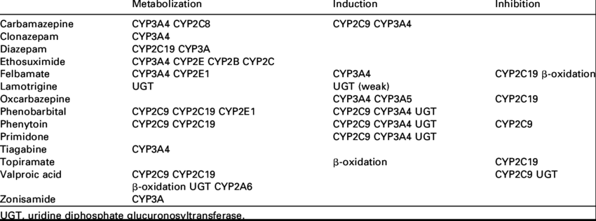
Example P450 Drugs

Slide 25
Drug Excretion
Removal of Drug from the body (urine, sweat, bile, saliva, breast milk, lungs)
Renal Drug Excretion
Glomerular Filtration
Passive Tubular Reabsorption
Active Tubular Secretion
Breast Milk
Bile

Slide 26
Renal Function
Serum Creatinine levels
Produced at constant rate by muscle
Excreted at constant rate by kidneys
Unreliable in “elderly”
Creatinine Clearance
24 hour urine
Estimated
Sex * ((140 - Age) / (SerumCreat)) * (Weight / 72)
Sex: Male = 1; Female = 0.85

Slide 27
Pharmacogenetic Testing (PGx)
Predicting drug response based on patient’s genetic profile
Largely determined by
P450 enzymes (metabolism)
Transporter Mechanisms
Absorption
Distribution
Excretion
https://www.ncbi.nlm.nih.gov/pmc/articles/PMC3791676/

Slide 28
Pharmacodynamics
Dose – Response Relationships
Maximal Efficacy
Potency
Drug – Receptor Interactions
Receptor-Types
Selectivity
Theories
Mode of Action

Slide 29
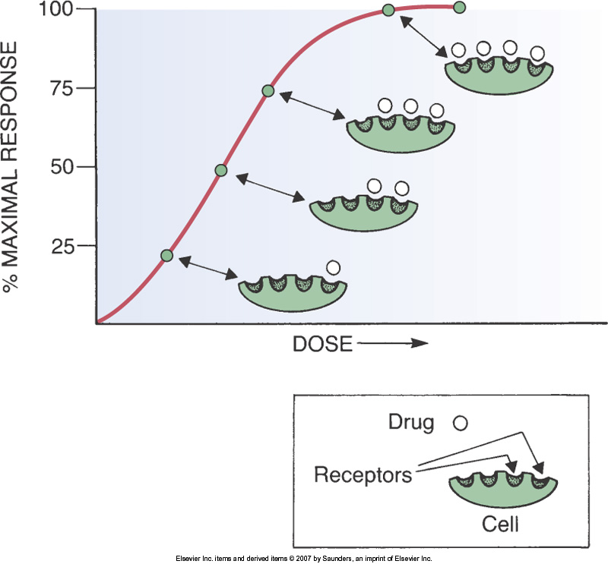
Dose Response

Slide 30
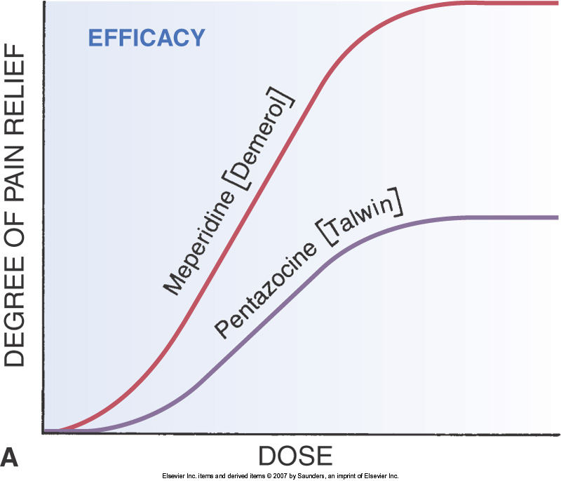
Maximal Efficacy

Slide 31
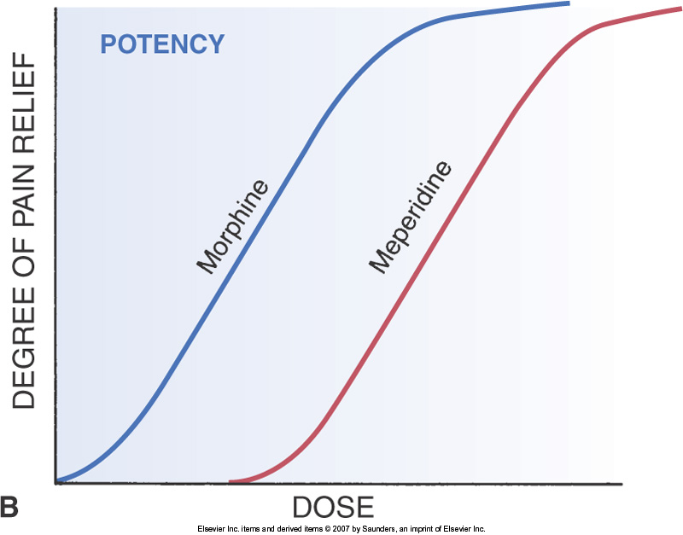
Potency

Slide 32
Mode of Action
Agonists
Antagonists
Partial Agonists
Regulation of Sensitivity
Selectivity
Lock and key

Slide 33
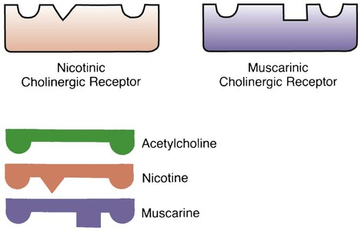
Example of Receptor Selectivity

Slide 34
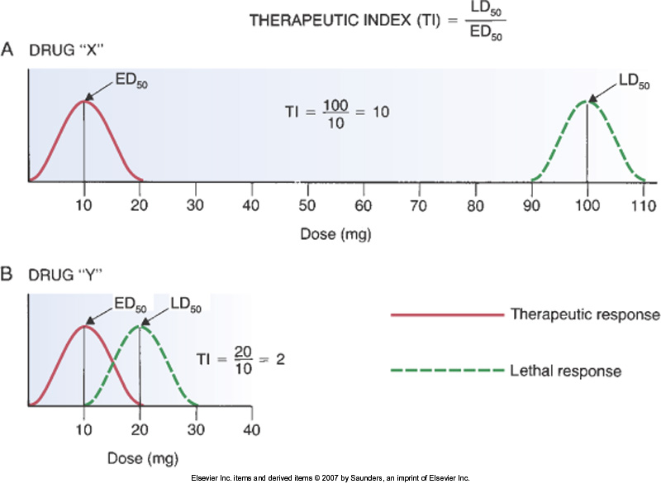
Therapeutic Index

Slide 35
Drug Interactions
Drug-Drug Interactions
Intensification: Effect and/or Adverse Effects
Reduction
Food-Drug Interaction
Absorption
Metabolism
Toxicity
Action
Food-Herb Interactions

Slide 36
Adverse Effects
Side Effect
Toxicity
Allergic Reaction
Idiosyncratic
Iatrogenic
Withdrawal Syndrome
Carcinogenic
Teratogenic
SUPER IMPORTANT
VOCABULARY

Slide 37
Medication Errors
Any preventable event that may cause or lead to inappropriate medication use or harm
13 types of errors (see Table 7-3, pg 67)
Causes of Medication Errors (90%)
Human factors
Performance deficits (30%)
Knowledge deficits (14%)
Miscalculation of doses (13%)
Communication Mistakes (15%) – handwriting, confusing abbreviations, decimals, apothecary vs. metric units
Name Confusion

