Slide 1
HIV/AIDS
2014

Slide 2
Basic Definitions
AIDS – Acquired Immunodeficiency Syndrome
Final Stage of HIV infection
HIV – Human Immunodeficiency Virus
Thought to be primary cause of AIDS
Thought to attack CD4 cells (including T helper cells)

Slide 3
AIDS Diagnostic Criteria
CD4 < 200
At least one of the CDC identified AIDS related diseases
E.g., PCP, CMV, TB, KS, Herpes, Candidiasis, others
Note that HIV infection is not a diagnostic criteria.

Slide 4
HIV Infection
Seropositive (2 weeks)
ELISA test
Western blot
Rapid HIV antibody tests (10-20 minutes)
Saliva, blood, urine
Western blot is always used to confirm ELISA or Rapid tests.
Seroconversion window: up to 6 months

Slide 5
HIV Antigen Test
PCR – Polymer Chain Reaction
Replicates fragments of Viral RNA
Can detect virus within weeks of exposure
Viral load
Used to gauge effectiveness of therapy
Goal of treatment is to take Viral load to zero

Slide 6
Etiology of AIDS
First cases were of rare cancers and opportunistic infections in otherwise healthy men
Early hypotheses
GRID: Gay Related Immunodeficiency Disease
Bloodborne disease, probably sexually transmitted
Lifestyle factors
Microbial overload
Superinfections
Poppers
Sexual practices

Slide 7
Etiology
Early Hypotheses continued
Confounding factors
Injecting drug users
Heterosexual transmission
Transfusions
Later
Retrovirus
HTLV-I or HTLV-II
LAV or HTLV-III

Slide 8
HIV Structure
Retrovirus: reverse transcriptase plus RNA
Core Proteins
Capsid
Lipid bilayer membrane

Slide 9
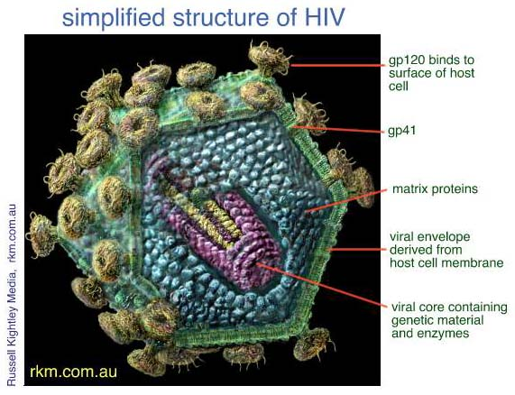

Slide 10
HIV Replication
HIV attaches to host cell via host cell’s CD4 molecule
HIV lipid bilayer fuses to host cell membrane. Viral RNA is released into cell
RNA is transcribed into SS DNA by reverse transcriptase
Reverse transcriptase converts SS DNA into DS DNA
DS DNA is integrated into host DNA by viral integrase
DNA undergoes normal transcription: vRNA + mRNA
mRNA is translated into HIV glycoproteins, HIV enzymes, and structural proteins
Components migrate to cell surface: a) HIV glycoproteins incorporate into cell membrane; b)Other components are assembled into virus.
Newly formed virus buds off of the host cell. Cell membrane of the host becomes membrane of the virus
During or immediately after budding, protease cleaves virus proteins into final active form

Slide 11
https://www.youtube.com/watch?v=hdgNnXLY8LU

Slide 12
HIV Replication rate
Viral Load
Initial phase as many as 1,000,000
Viral load 1,000 – 100,000
Half life of 6 hours
Rate of replication to sustain viral loads above 1 – 10 billion viruses/day
Mutation and Drug Resistance
Reverse transcriptase
Higher viral load

Slide 13
HIV Transmission
Present in all body fluids (universal precautions)
Sexual contact
Transfusion
Sharing IV needles
Accidental needle sticks
Blood contact

Slide 14
U.S Statistics
More than 1.1 million in America with HIV
15% are unaware they have it
Incidence ~50,000 new cases per year
MSM have highest rate of transmission
Blacks have dramatically higher risk
12% of population; 44% of new cases
Hispanics
16% of population; 21% of new cases

Slide 15
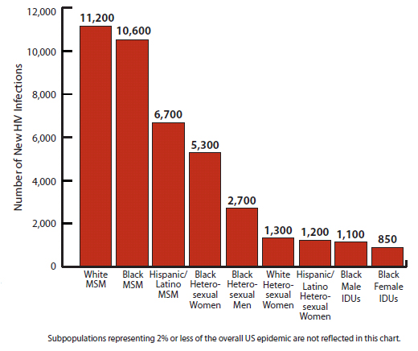

Slide 16
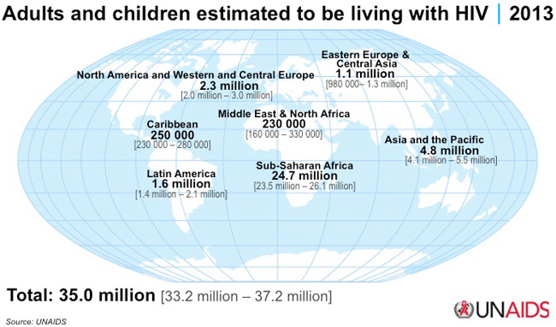

Slide 17
Worldwide
Vast majority of HIV is in sub-Saharan Africa
HIV in Africa
Primarily heterosexual
Kills much faster
Originally led researchers to believe it was a different disease
Drivers
Urbanization
War
Poverty

Slide 18
Pathophysiology
HIV potentially infects all cells with CD4 surface molecules
Dendritic cells
Helper T cells
Macrophages
Killer T cells
NK cells
Microglial cells
In addition to CD4, CCR5 or CXCR4 coreceptors are required
CXCR4 preferring: T cell tropic
CCR5 preferring: macrophage tropic

Slide 19
Patho Continued
Initial infection site is usually mucosal lymphoid tissue
T cells or Dendritic cells are infected
When they are activated they…
Infected T cells
Produce virus
Undergo apoptosis
Are targeted by Killer T cells

Slide 20
Patho continued
All infected cells shed viral protein GP120, which induces death in uninfected
T cells
Neurons
Monocytes
Activated T cells are most susceptible
T memory cells more

Slide 21
Clinical Manifestations
Inoculation
Window phase: Seronegative
Subclinical: HIV syndrome (50 – 90%)
Fever, rash, pharyngitis, myalgias, headache
Latent phase
No disease
1 – 10 years
AIDS

Slide 22
Treatment
Nonpharmacological
Nutrition
Exercise
Social Support
Hygiene
Pharmacological: HAART
Nucleoside Reverse Transcriptase inhibitors (NRTIs)
Non-Nucleoside Reverse Transcriptase inhibitors (NNRTIs)
Protease inhibitors (PIs)
Intregrase inhibitors

Slide 23
NRTIs
Inhibit reverse transcription by pretending to be a nucleoside: DNA base plus backbone.
AZT (ZDV, Zidovudine, Retrovir)
First HIV drug discovered
Converts to ZTP, which acts as a substrate to RT
Incorporates into the chain
Prevents further transcription
Adverse effects
Anemia
Neutropenia
Lactic acidosis (rare)
GI, CNS, Myopathy
Increased risk of hepatotoxicity with ganciclovir

Slide 24
AZT Prophylaxis
Used to prevent infections in
At risk Needlesticks
Among sexual partners where one partner is HIV positive
Pregnant mothers
Largely replaced by Tenovir now

Slide 25
NNRTIs (active only against HIV-1)
Directly inhibits reverse transcriptase
Nevirapine (Viramune)
Binds directly Reverse Transcriptase
Adverse
Rash
Stevens-Johnsons
Hepatotoxicity
Efavirenz (Sustiva)
Adverse effects: CNS, teratogenic

Slide 26
Protease inhibitors
Inhibit final maturation step of viral replication
Most effective, but
Resistance
Adverse effects
Hyperglycemia/Diabetes
Fat distribution
Hyperlipidemia
Increase risk of bleeding in hemophiliacs
Reduced BMD
Elevation of Liver enzymes
Multiple interactions
Saquinavir (Fortovase)
Indinavir (Crixivan)

Slide 27
Newer Drugs
Integrase inhibitor
Integration of HIV DNA into human DNA
Indicated only for patients experiencing resistant strains
Fusion inhibitor
Very expensive
Twice daily SQ injections
CCR5 Blocker
CD4 Co-receptor; effective against certain strains

Slide 28
HAART
Highly Active Anti-Retroviral Therapy
Combination of 2 NRTIs plus
NNRTI or
PI
Goal Prevent resistance
Target
Viral load

Slide 29
Controversies
Who is at risk?
Research budget
U.S. vs Africa
HIV plus?
Can HIV be cured?

